Slide 2
Objectives
Define and describe Language Integrated Query (LINQ)
List and describe the commonly used query operators
Describe the use of LINQ to query different data sources
Explain the ADO.NET Entity Framework
Describe Entity Data Model (EDM)
Describe creation of a simple Entity Data Model
Describe creation of a Windows Forms Data Source using EDM
Describe data retrieval using the EDM

Slide 3
LINQ 1-2
Windows Forms applications use ADO.NET for data handling
To overcome data handling issues, Microsoft introduced LINQ
LINQ queries data from diverse sources
These data sources must be LINQ-compatible
LINQ can be used with SQL, XML, Objects, ADO.NET DataSets, Entities, and so on

Slide 4
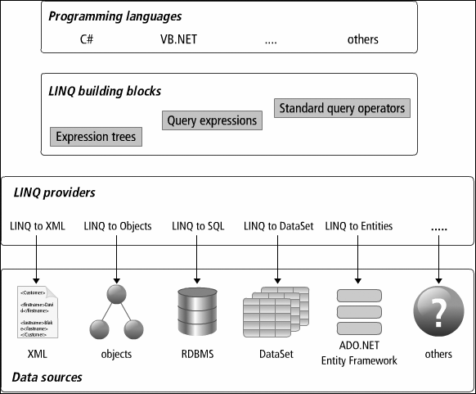
Notes:
LINQ to SQL : MS SQL (không sử dụng được cho My SQL)

Slide 5
Using LINQ, you can work with queries as part of the C# language
You can use query expressions that are used to query and transform data from a data source
Query expression is a query that uses clauses like from, select, orderby, and so on

Slide 6
LINQ 2-2
The example populates a ListBox with the elements from an array that are greater than 50.
Snippet
. . .
int[] points = { 15, 105, 89, 33, 60, 124, 68, 23, 58, 91};
// Query expression
IEnumerable<int> result =
from point in points
where point > 50
orderby point
select point;
foreach (int i in result)
{
lstResult.Items.Add(i);
}

Slide 7
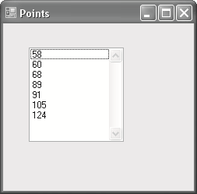
Output

Slide 8
Commonly used Standard Query Operators
Represent the operations in LINQ for tasks such as filtering, counting, aggregating, sorting, and so on
Provide querying capability over the collection on which they operate
Are static methods of the static classes, System.Linq.Enumerable and System.Linq.Queryable

Slide 9
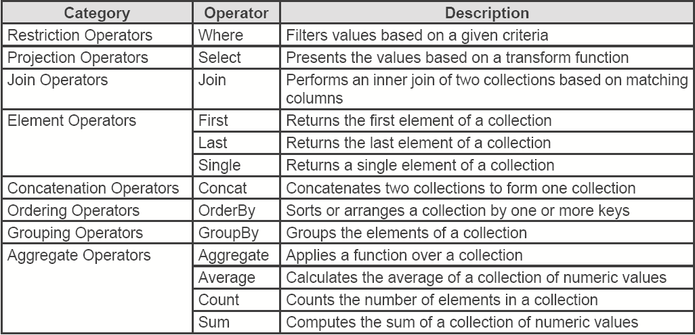

Slide 10
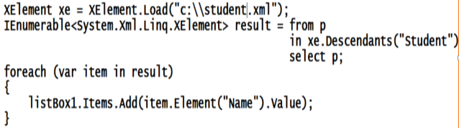
LINQ to XML
Creates, stores, and retrieves XML data
Important classes of LINQ to XML are XDocument, XElement, and XAttribute
These classes are defined in System.Xml.Linq namespace

Slide 11
LINQ to Objects
Enables you to write queries over any enumerable collection, such as arrays, lists, and collection
Queries any collection that implements interfaces, IEnumerable, IQueryable, or IEnumerable(Of T)
LINQ queries are better than foreach loops when querying in-memory collections and objects

Slide 12
LINQ to SQL 1-6
Queries and manipulates data from SQL Server databases
Requires a reference to System.Data.Linq namespace
Maps the data object model using Table and Column attributes
DataContext object contains the information to connect to the database
DataContext converts the requests for objects into SQL queries against the database and then converts the results into objects

Slide 13
LINQ to DataSet
Enables you to write queries from within C# applications, instead of using a separate query language
LINQ capabilities can be used with DataSet to construct complex queries
LINQ support for DataSet is implemented entirely in System.Data.Extensions.dll
A DataSet must be populated with data before LINQ queries can be performed on it

Slide 14
ADO.NET Entity Framework
Introduced with Visual Studio 2008 and ADO.NET 3.5
An Object-Relational Mapping (ORM) framework consisting of a data model and a set of design-time and run-time services
Enables to run queries using LINQ and retrieve and manipulate data in the form of strongly typed objects
Enables writing .NET applications against classes generated from the conceptual layer
An entity is a concept in the domain of an application from which a data type is defined

Slide 15
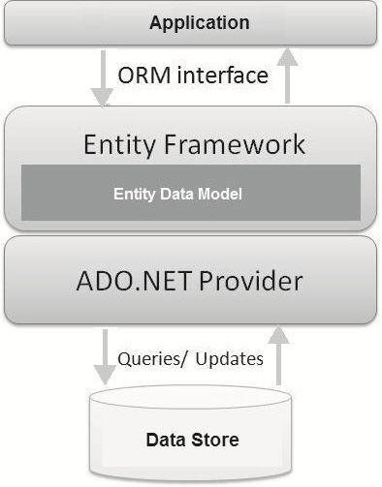

Slide 16
ADO.NET Entity Framework - Advantages
Lesser development time
Capabilities and benefits of LINQ can be leveraged through LINQ to Entities
LINQ support enables the use of IntelliSense and helps to validate query syntax based on the conceptual model at compile-time
Exposes data as strongly typed objects so that inheritance and reflection features can be used
Work with applications that support a conceptual model independent of the physical/storage model
No need to frequently change the application code whenever any mapping between the object model and the storage-specific schema changes

Slide 17
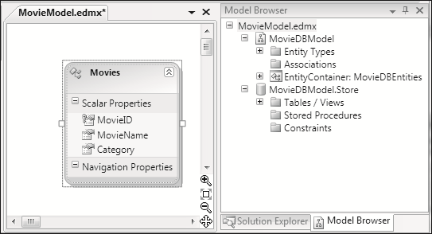
Creating a Windows Forms Data Source using Entity Data Model

Slide 18
Example of Data Source using Entity Data Model
MovieModel model;
private void Form1_Load(object sender, EventArgs e)
{
model= new MovieModel();
var qr=(from m
in model.Movie
select m.MovieId);
comboBox1.DataSource = qr;
}
private void comboBox1_SelectedIndexChanged(object sender, EventArgs e)
{
string movieId= this.comboBox1.SelectedItem.ToString();
var qr = from m in model.Movie
where m.MovieId==movieId
select m;
dataGridView1.DataSource = qr.ToList();
}

Slide 19
Summary 1-2
LINQ is a set of technologies introduced in Visual Studio that simplifies data access in various formats from different data sources.
A query expression is a query that is written in query syntax and is used to query and transform data from a LINQ-compatible data source.
Standard query operators represent the operations available in LINQ and are used for tasks such as filtering, counting, aggregating, sorting, and so forth.

Slide 20
Summary 2-2
LINQ can be categorized into following flavors: LINQ to SQL, LINQ to XML, LINQ to Objects, and LINQ to DataSets.
ADO.NET Entity Framework is an Object-Relational Mapping (ORM) framework integrated into Visual Studio.
The Entity Data Model (EDM) is an Entity-Relationship data model used in ADO.NET Entity Framework that describes the application-specific objects.

